Slide 1

Settling In Evening October 2023 KSHS
Aims of this session:
To understand the structures in school to support your child’s wellbeing
To share resources on parental controls, Whatspp and screentime

Slide 2
The transition to secondary school, GCSE’s & Year 7
As parents and carers, we play an important role in teaching children and young people how to understand and manage their feelings as they grow up.

Slide 3
What can I do at home?
Find time to talk, just the two of you – ‘Check in’ with them while you’re doing things together, so they get used to talking about their feelings.
01
Spend time together (play games together) – Play helps them to be curious, learn new things, solve problems and express feelings without words.
02
Be a role model – Show how you cope with difficult feelings and look after yourself.
03

Slide 4
Big changes can have an impact on our mental health – here are some useful links.
Bereavement and grief (Child Bereavement UK) or (Winston's Wish)
Divorce and separation (Young Minds)
Getting ready to start school (Place2Be)
Adolescence and growing up (The Mix)
Exam stress (Place2Be)
MHST – Lincolnshire’s Mental Health Support Teams (here this evening)
KOOTH – online help for you and your child

Slide 5

Tier 5
CASY
Counselling
Tier 4
External professionals
Tier 3
Listening Service
Tier 2
Wellbeing Ambassadors
Tier 1
Universal support. Tutor activities, Personal Development and PSHE activities, newsletter articles and wellbeing activities. The library and Wellbeing Hub are spaces for you to use and promote your wellbeing
Where can you go for help?
KSHS
5 tiers of support

Slide 6

Staying safe online – Whatspp, screen time & parental settings

Slide 7
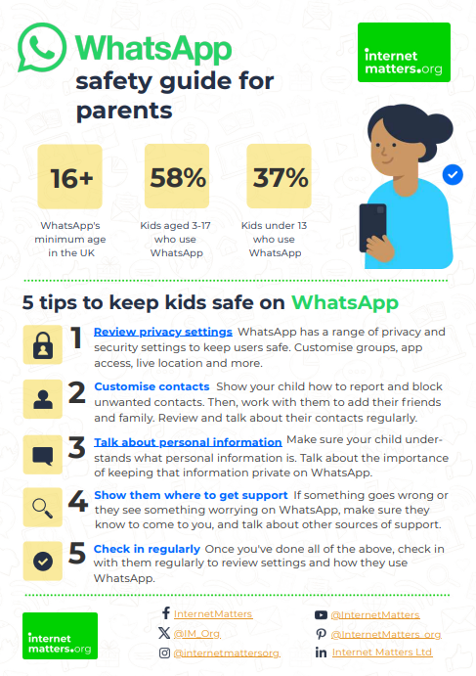

Slide 9

Notes:
https://www.youtube.com/watch?v=Bq7DSfBgoYk&t=5s

Slide 10
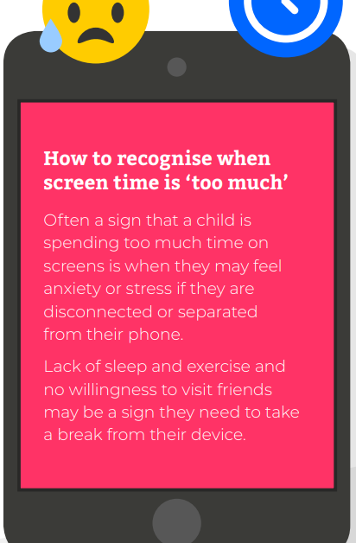
Set boundaries to help them build good online habits
Stay engaged in what they do online
Equip them with know-how to manage risks online
Give them the space to become digitally resilient
Encourage children to review when and how they use their screen time with tools

Slide 12
Parental Controls & Privacy settings – a link to support you to set these up
Parental Controls & Privacy Settings Guides - Internet Matters
Notes:
Parental Controls & Privacy Settings Guides - Internet Matters

Slide 13



Some recommended reading

