Slide 1

A Parent’s Guide to Assessment in Years 7-9
Gaynor White – Assistant Headteacher - Curriculum

Slide 2
Formative vs Summative Assessment
Formative
Summative
Occurs during the learning process
Assessment for Learning
Allows teachers to adapt their teaching to meet the needs of the group/ student. Student can reflect and improve their work
On-going
Often low stakes
Identifies areas for improvement
Helps move the learning forward
Occurs at the end of the learning process
Assessment of Learning
Provides a final evaluation of knowledge and skills
More Formal
May provide students with a grade or mark

Slide 3





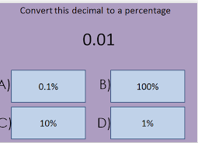

Formative Assessment could look like this…

Slide 4








Summative Assessment

Slide 5





Peer Assessment Feedback
Remember this is someone else's work
Kind (but honest)
Focus on good work and be positive.
EXAMPLES
The best paragraph is…because…
The best sentence is…
It was great how you…
There were lots of facts such as…
Helpful (…so that…)
Give helpful examples and ideas how they can improve.
EXAMPLES
Perhaps next time you could…
Make sure you proof read your work
To improve try to use more/less…
Specific (be precise)
Pick out specific words and sentences. Give an exact idea of where and when improvement can occur. Go into depth
and explain what you mean.
EXAMPLES
In the…paragraph you could have…
Use evidence to support your idea…
Write your name at the bottom of your peer’s work
Marked by…
Proof read your peers work.
Underline any spelling mistakes and mark any grammar mistakes using the marking guide.
Marking Guide
Sp – Spelling mistake.
x3 – Write out correct spelling 3 times.
CL – Change this to a capital letter.
P – Correct this punctuation error.
// - Start a new paragraph here.
Gr – Correct this grammar error.
? – This does not make sense.
Highlight any keywords used.
Have they met the success criteria? How?
Do you have any questions for them?
How do you think they can improve their work? Use success criteria and grade descriptors.

Slide 6
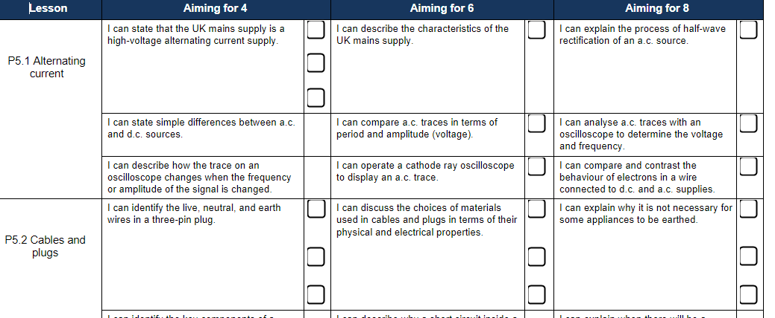
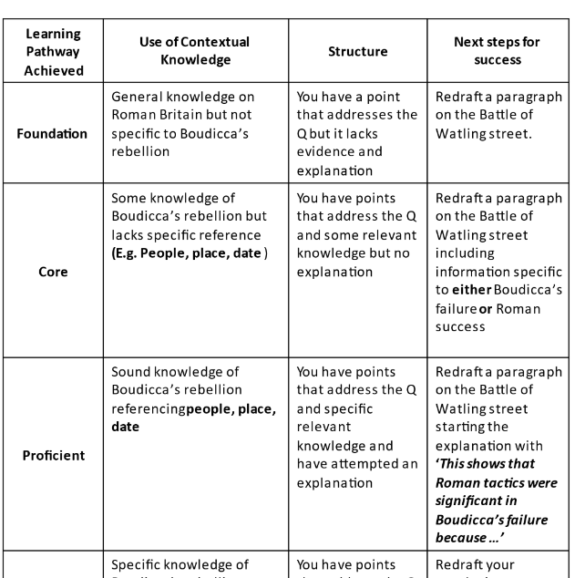
Self Assessment

Slide 7

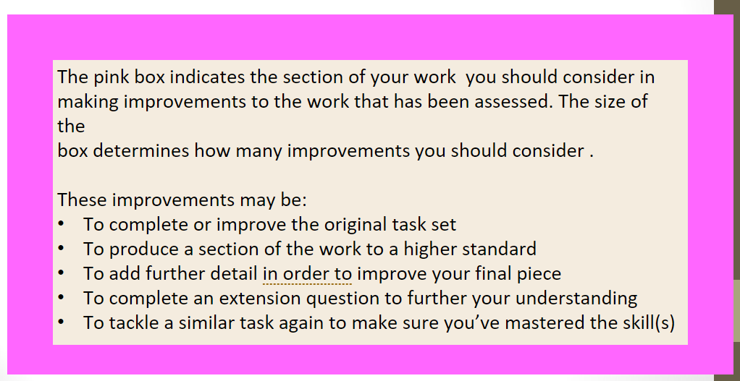
What could happen next in the classroom…

Slide 8
Targets and Current Working Level in KS3
The KSHS/Carre’s model for Key Stage 3 Assessment is based on the principal of learning Paths, and each student’s work is measured in relation to these learning paths.
Based on prior attainment and professional judgement students are assigned a Learning Path in each of their subjects.

Slide 9
Determining a Target Working Level
Your daughter is likely to have got a score of around 110 as a result of her KS2 SATS (the national average was 105 this year. A score of 100 is an indication of being secondary school ready)
 | Average scaled score in reading | Average scaled score in maths | Average scaled score in grammar, punctuation and spelling
2015/16 | 103 | 103 | 104
2016/17 | 104 | 104 | 106
2017/18 | 105 | 104 | 106
2018/19 | 104 | 105 | 106
2019/20 | x | x | x
2020/21 | x | x | x
2021/22 | 105 | 104 | 105
2022/23 | 105 | 104 | 105
2023/24 | 105 | 104 | 105
2024/25 | 106 | 105 | 105

Slide 10
The KS2 results are used as a starting point for determining each students target learning path in the majority of subjects.
Learning Pathways and targets in school are based around FFT targets.
When this data is missing teachers assess in comparison to their peers.

Slide 11
Baseline Testing for
Art
Drama
Music
PE

Slide 12
Core
Proficient
Exceptional
Foundation
This work is currently judged to be the work of a pupil who is working towards GCSE grades 1-3 in Years 10 & 11
This work is currently judged to be the work of a pupil who is working towards GCSE grades 4-5 in Years 10 & 11
This work is currently judged to be the work of a pupil who is working towards GCSE grades 6-7 in Years 10 & 11
This work is currently judged to be the work of a pupil who is working towards GCSE grades 8-9 in Years 10 & 11

Slide 13
Effort Grades
1* – Exceptional Effort | Exceptional Effort means being committed to getting the most out of all learning opportunities available.
1 – Good Effort | Good Effort means being a responsible and hard-working student, who tries their best all the time.
2 – Satisfactory Effort | Satisfactory Effort means a student can work well but sometimes not to their full potential
3. Inconsistent Effort | Inconsistent Effort means that a student is probably failing to push herself or make the most of the opportunities available.
4. Poor Effort | Poor Effort means that a student needs additional support to become a more responsible learner

Slide 14
Concern Codes
If a subject teacher has a particular concern regarding the work or attitude of a student in a particular area, the following concern codes may be reported:
H | Homework
O | Equipment/Organisation
A | Attendance/ Punctuality
B | Behaviour
P | Participation and Engagement

Slide 15
Core
Proficient
Exceptional
Foundation
This work is currently judged to be the work of a pupil who is working towards GCSE grades 1-3 in Years 10 & 11
This work is currently judged to be the work of a pupil who is working towards GCSE grades 4-5 in Years 10 & 11
This work is currently judged to be the work of a pupil who is working towards GCSE grades 6-7 in Years 10 & 11
This work is currently judged to be the work of a pupil who is working towards GCSE grades 8-9 in Years 10 & 11

